Slide 1
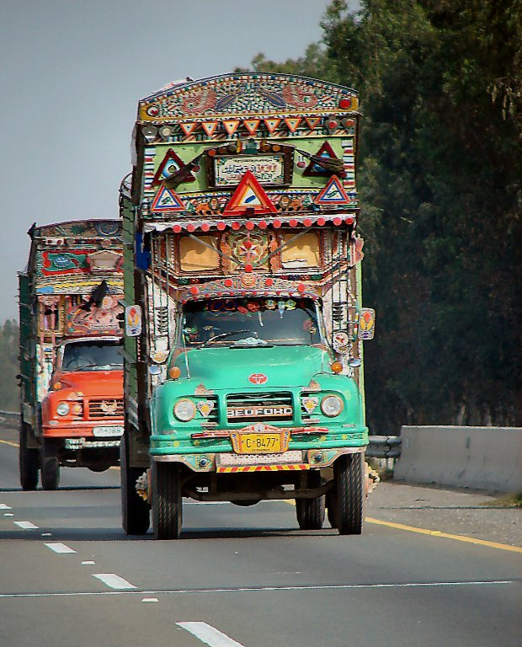
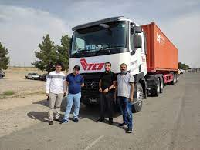

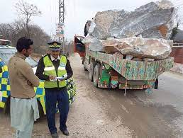
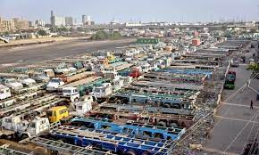
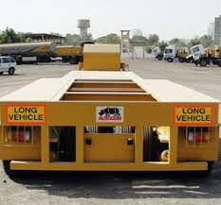
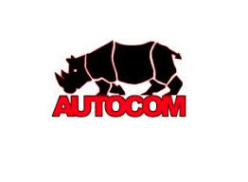
Moonshot to Modern Trucking
Khayam Husain
Automobile Corporation of Pakistan
October 27, 2022

Slide 2
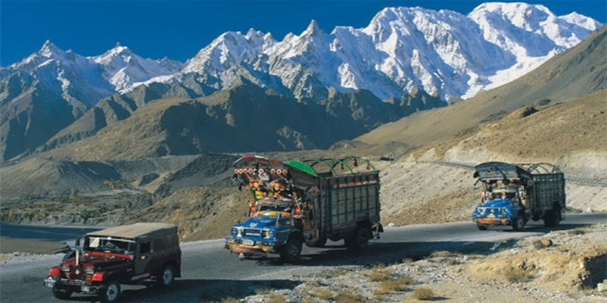
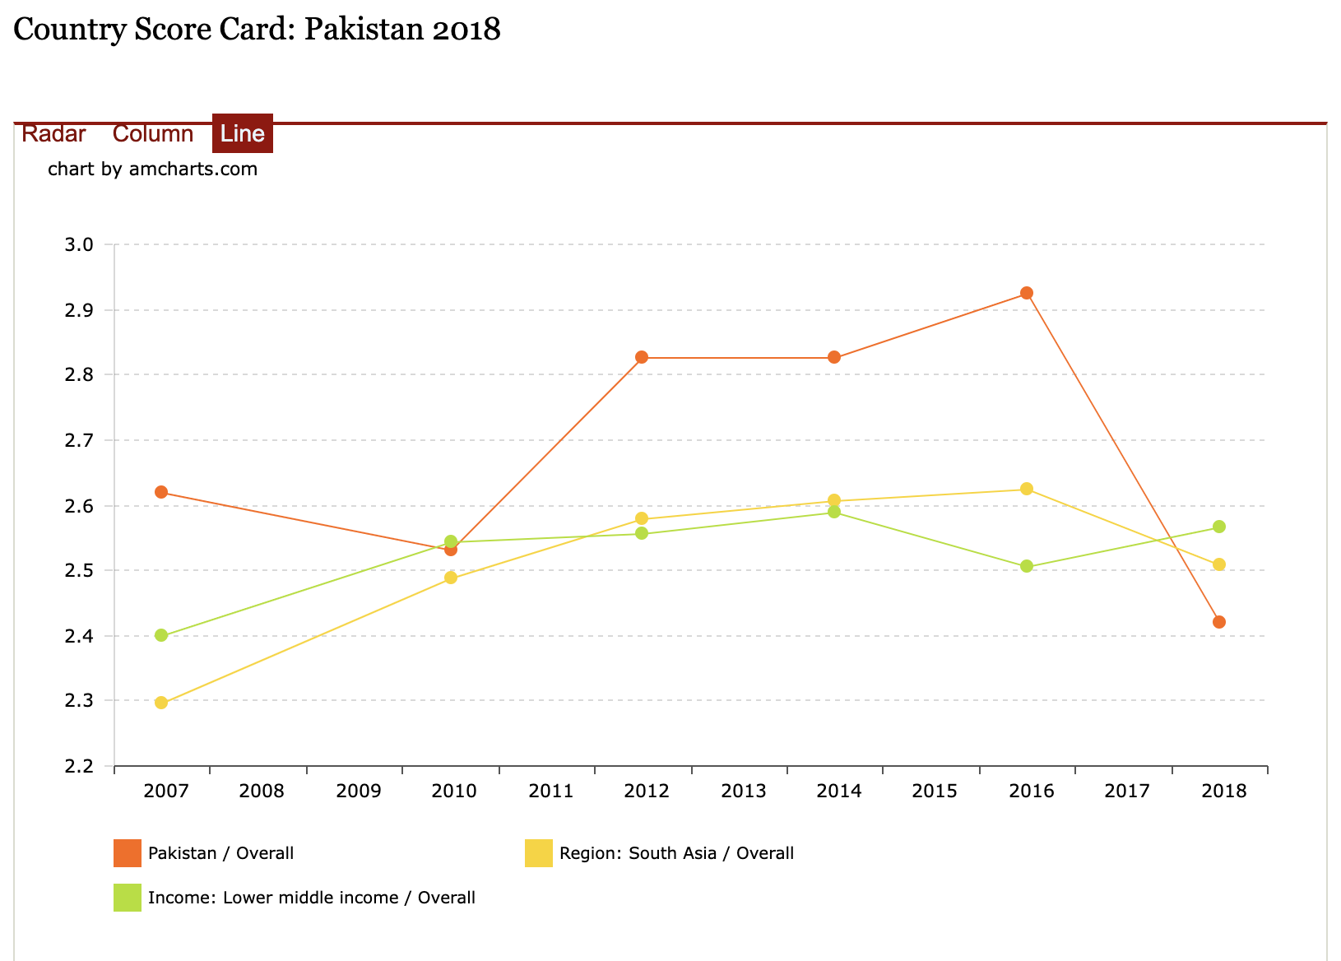
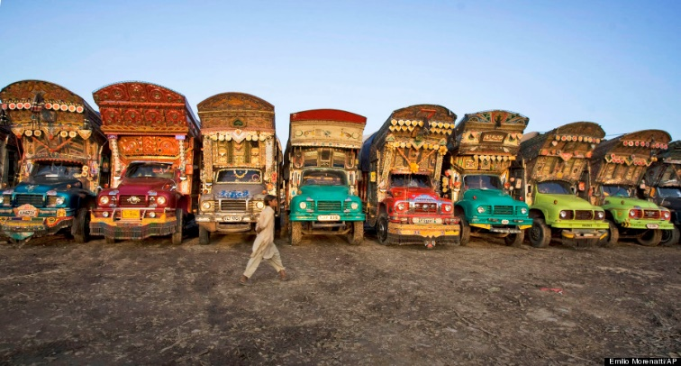
Trucking Industry – Reality
Trucking in Pakistan is characterized by low service quality, low margins, low value, low safety
According to the Logistics Performance Index of the World Bank, Pakistan’s performance on most logistics indicators, including the quality of trade and transport infrastructure, is worse than that of other Asian countries. We rank at 122/155 and are slipping (see graph).
Freight sector inefficiencies are costing the national economy about Rs150 billion annually according to a report by the World Bank.
The trucking sector is worth USD 30 billion annually. It carries 96 per cent of the total freight traffic. However, it is highly fragmented and suffers from a poor image problem.
Notes:
There is no long term government plan to develop logistic value chain as a means to climb out of the economic black hole Pakistan is trapped in.

Slide 3
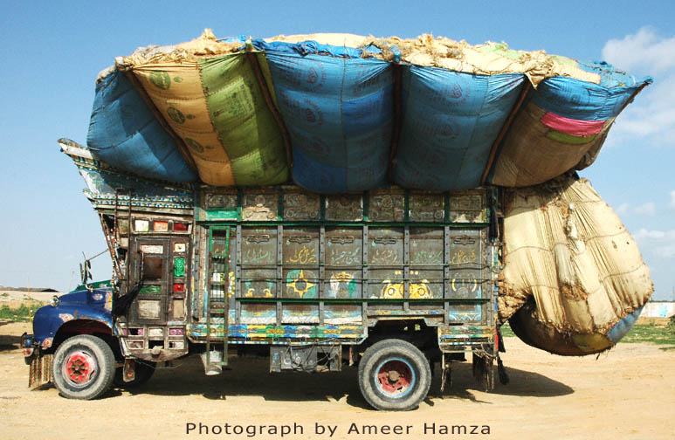
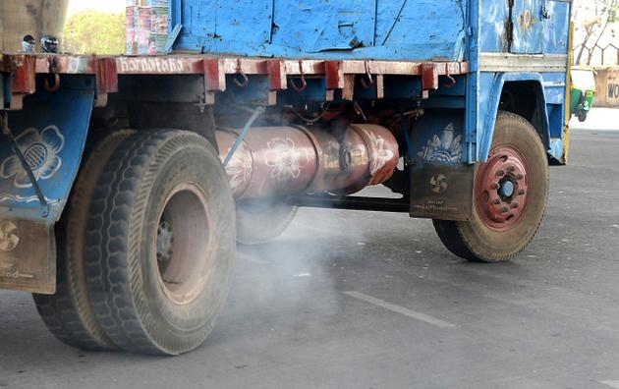
Logistics / Trucking Industry - Challenges
Largely unregulated logistics / road freight sector and the lack of a trucking policy
Obsolete and outdated fleet composition
Absence of government implementation on axle loads
Informal manufacturing and enhancement of capacity in after market
Lack of professional, licensed commercial vehicle drivers
A slum-like emergence of unlicensed workshops, service facilities and spare parts outlets
Roads deterioration due to high legal axle loads which are further overloaded by 100% at times
No registration of semi trailer as a vehicle hence lack of traceability
Notes:
Modern Trucking will create thousands of new jobs and improve export competitiveness. The nations with top twenty LPI are among the 10 strongest economies of the world. We have a deteriorating Balance of Payments and there is a dire need to move to the modern goods exports (as well as service sector exports) to earn more foreign exchange. The need is to eradicate supply chain inefficiencies in bringing products, raw materials and finished goods to market. That is how Pakistan’s exports will become competitive.
Old inefficient, over loaded trucks cause external costs like road accidents, spoilage due to time lags and damage to roads, bridges and highway infrastructure. It yields 2% loss to GDP on average – around USD 6 billion

Slide 4
State of the Road Freight Industry
Trucks carry 96% of total freight.
Truck fleet of around 350,000 vehicles.
Limited professional Fleet Operators
  Low service quality, low margins, low value, low safety
Informal financing
Obsolete, primarily a rigid trucking fleet
75% 2-3 axle rigid, only 25% multi-axle
Truck companies are price takers
Truck companies have to suffer detention time at their own cost
Lack of modernization incentives for Road Freight
The Industry Development is Tied to Implementation of Axle Load Regime

Slide 5
Logistics / Trucking Industry – Facts & Figures
Composition of Truck Traffic Volume w.r.t Axle Configuration
Sr. No. | Axle Configuration | Code | NTRC 1995 |  | NTRC 2019
 |  |  | Volume | Percentage | Volume | Percentage
1 | 2 Axle Single | 1.2 | 53,864 | 68.01 | 82,664 | 35.81
2 | 3 Axle Tandem | 1.22 | 17,757 | 22.42 | 57,240 | 24.79
3 | 3 Axle Single | 1.2-2 |  |  | 2,004 | 0.87
4 | 4 Axle Single Tandem | 1.2-22 | 5076 | 6.41 | 30,744 | 13.32
5 | 4 Axle Tandem Single | 1.22-2 |  |  | 1,443 | 0.63
6 | 4 Axle Single | 1.2+2.2 |  |  | 41 | 0.02
7 | 5 Axle Single Tandem | 1.2-222 | 2503 | 3.16 | 12,491 | 5.41
8 | 5 Axle Tandem Tandem | 1.22-22 |  |  | 8,027 | 3.48
9 | 5 Axle Single Single Tandem | 1.2+2.22 |  |  | 304 | 0.13
10 | 5 Axle Tandem Single Single | 1.22+2.2 |  |  | 156 | 0.07
11 | 6 Axle Tandem Tridem | 1.22-222 |  |  | 35,403 | 15.34
 | TOTAL |  | 79,200 | 100.00 | 230,856 | 100.00
Source: NTRC, Min of Communications

Slide 6
Logistics / Trucking Industry - Opportunities
Enhancement in regional connectivity – transit trade agreements like QTTA, UN-TIR, and ATA
Post Pandemic integration with China on CPEC
Development of road infrastructure, freight villages and logistics centers
Generation of opportunities in logistics sector (coal movement from Thar coal mine, thriving cement sector, LPG/LNG energy sector, steel sector, agri business like DAP, wheat and FMCG)
Modernization of trucking fleet with integration of smart technology
Entry of big businesses in Freight and Logistics such as Interloop (Momentum), US Apparel (LEEDS), Colony Textile (Haulrite) and Engro (Engro Logistics).
Stimulus for growth required for professional haulage companies represented by Fleet Operators Association of Pakistan

Slide 7
Trucking Industry – 3 Big Issues & Their Solutions
a. Trucking has remained a cottage industry with owner-drivers lacking financial prowess, technology and and training.
Solution: Trucking to be made into an industry and provided government support in shape of loans similar to the TERF financing to modernize and kick-start the manufacturing sector. Defining the minimum age requirement for trucks as part of National Priority Sector Export Strategy of GoP
b. Road Freight Industry not being able to modernize as successive governments have ignored the hazards of overloading -loss of life, loss of property and destruction of highways. Axle load regime in Pakistan is the most liberal in the region and yet it is not implemented. Trucking companies cannot become profitable with legal loads being carried in modern trucks. Highway construction is designed for carrying 8.5 tons per axle, we allow 12 tons per axle and move 18 tons per axle.
Solution: Axle load regime would be implemented in letter and spirit according to the NHSO 2000. There will be a backlash from certain segments when this law is implemented but the growth of the industry is dependent on modernizing of this segment.
c. Majority of Driver’s License for Heavy Duty Vehicles (HTV) are Fake
Solution: Process of issuance needs to be streamlined and made practical. Consultative meeting with stakeholders like the Fleet Operators Association should be initiated
Notes:
Inefficiencies with overloading means that our trucks consume at least 30% more diesel than we should. Almost 35% of the 713,000 tons of diesel consumed by the transport sector.

Slide 8
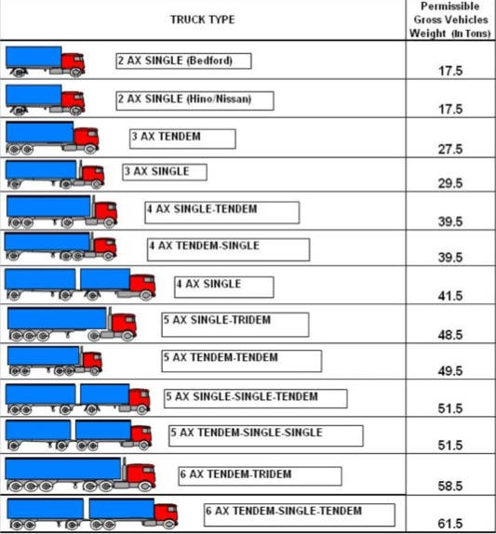
Pakistan - Most Liberal Load Limits (yet we overload…)
Source: www.unescap.org/sites/ default/

Slide 9
Distribution of Max. Gross Weights for Articulated Trucks
Source: www.unescap.org/sites/ default/

Slide 10
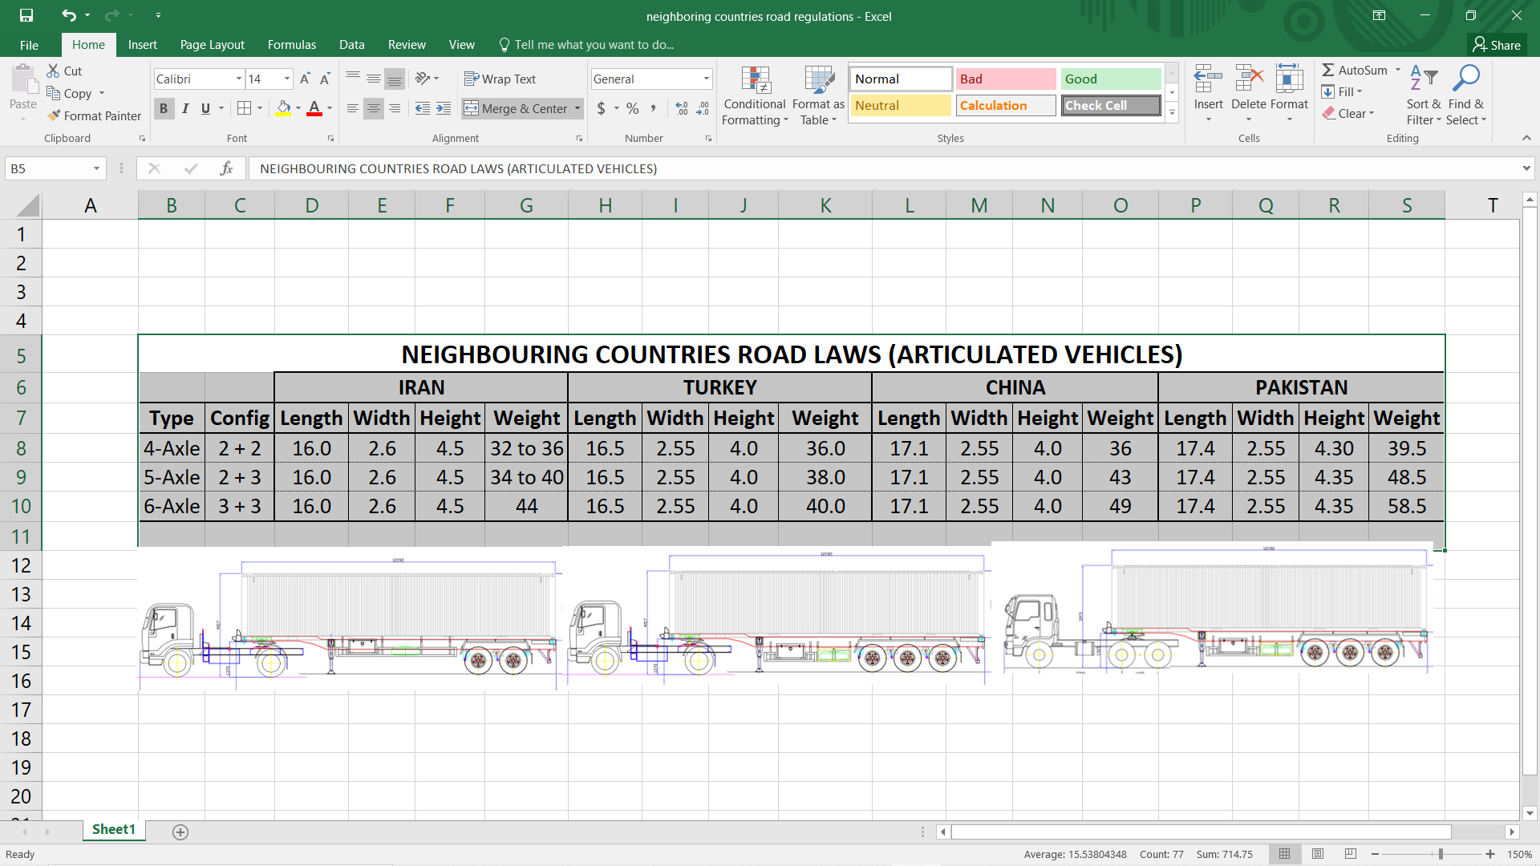
Pakistani Law allows:
Legal maximum weight 58,500 kg (highest in the UNESCAP region)
Legal maximum length
Pakistani trailers are built with heavy steel chassis, heavy suspensions, drum axles consuming excessive diesel.
By contrast neighboring countries trailers are built with special alloys, air suspensions and disc axles – keeping the weight low and hence lower fuel consumption.

Slide 11
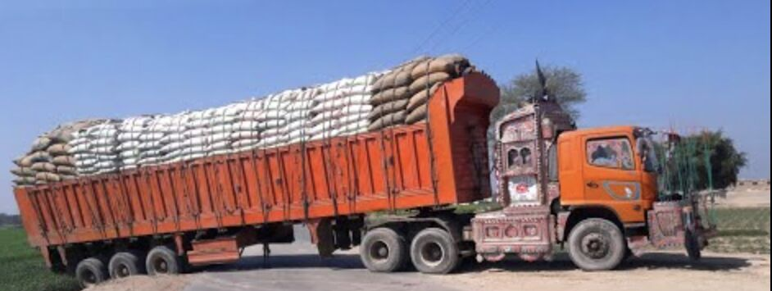
Typically Overloaded Semi-Trailer in Pakistan
GCW = 100 tons against allowed 58.5 tons
Breakdowns cause blockage of already fragile highway network

Slide 12
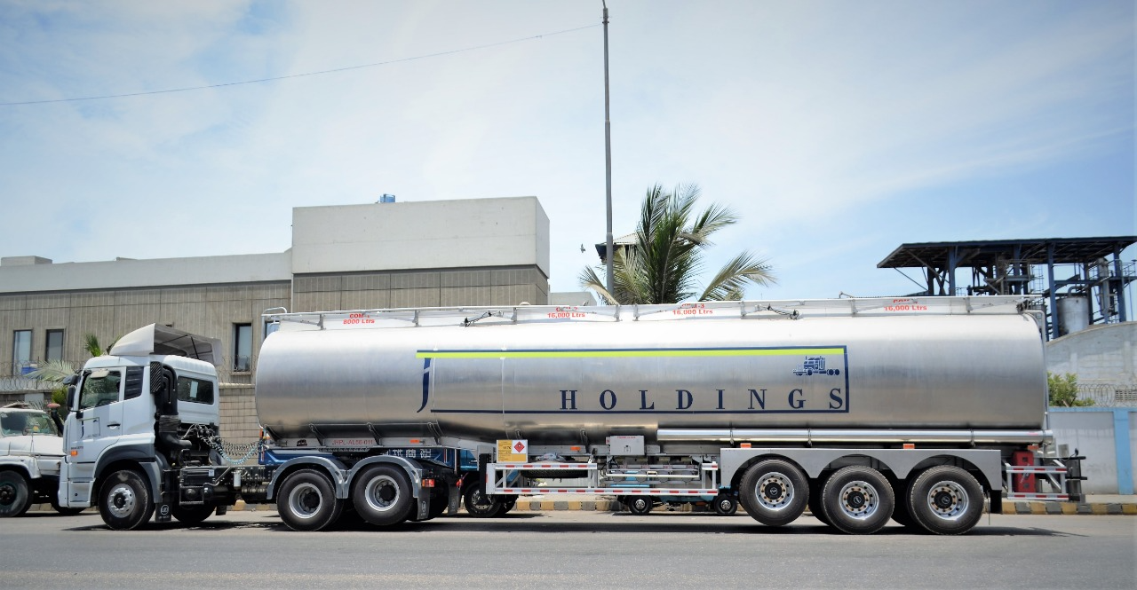
Truck of the Future…already being “Made in Pakistan”
Aluminum Construction
Rollover Stability System
Electronic Brakes (EBS)
Air Suspension
Lifting Axle
Aluminum Wheels
Tubeless Tyres

Slide 13
Semi-Trailer Industry – Recommendations
a. EDB Classification should incentivize semi-trailer builders to build international standard semi-trailers.
Solution: Categorize Semi-Trailer builders.
A- Category: Large (turnover of Rs. 1 b+ purpose specific plant and machinery)
These builders be allowed concessionary import of CKD kits to promote reefer, alloys, curtain siders and other special vehicles for enhancing export potential of road transport the industry.
B- Category: Small & Medium (turnover 100 m+, some covered sheds and machinery)
These builders should be asked to promote standards and ensure all semi-trailers have unique chassis nos. It should be clear that EDB quotas are for their own production only.
b. Fleet operators do not have easy access to semi-trailer finance due to lack of unique reg, no. of semi-trailers
Solution: Implement Semi-Trailer Registration System if built by licensed trailer builder. Also encourage financing of semi-trailers.
Additional Customs Duty on Components Reduced from 7% to 2% for Heavy Vehicles but not Semi-Trailers
Solution: FBR to be asked to harmonize the reduction by either abolishing or reducing ACD to 2%
Notes:
A 2016 National Highway Authority(NHA) report stated that international regulation overseeing long-hand traffic specify that articulated trucks(trailers) should constitute atleast 50% of the truck fleet, in Pakistan articulated trucks comprise only 12% of the total fleet. This is because of the need of massive investment which may not be possible for small & medium transporters to undertake.

Slide 14
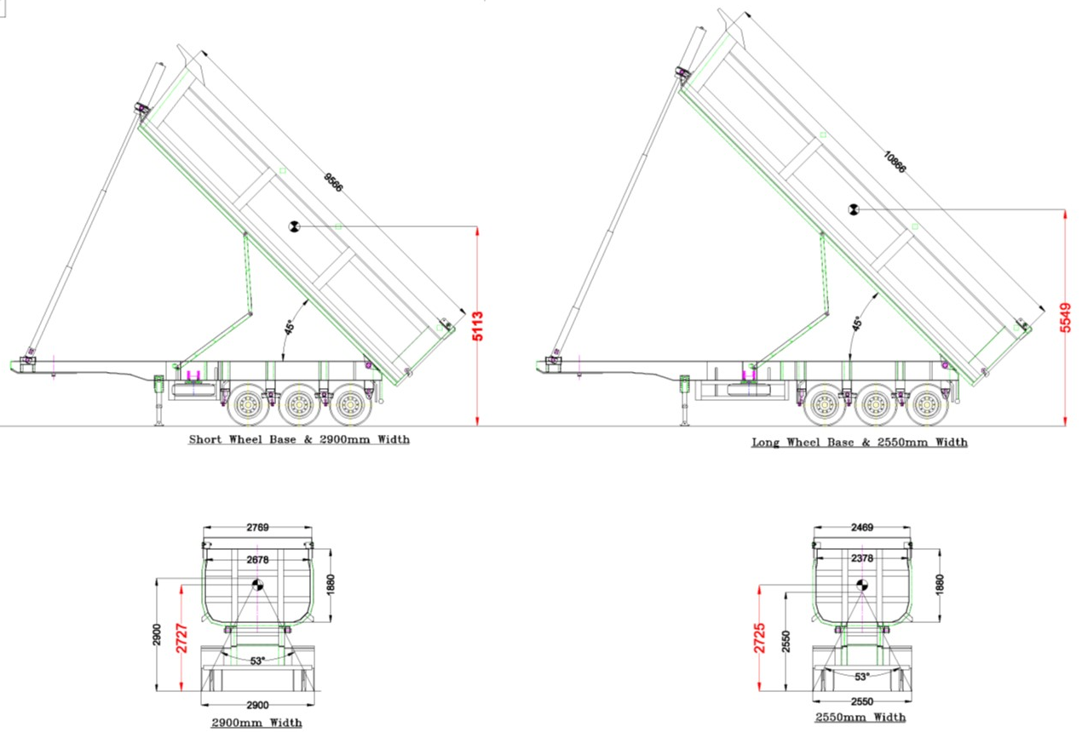
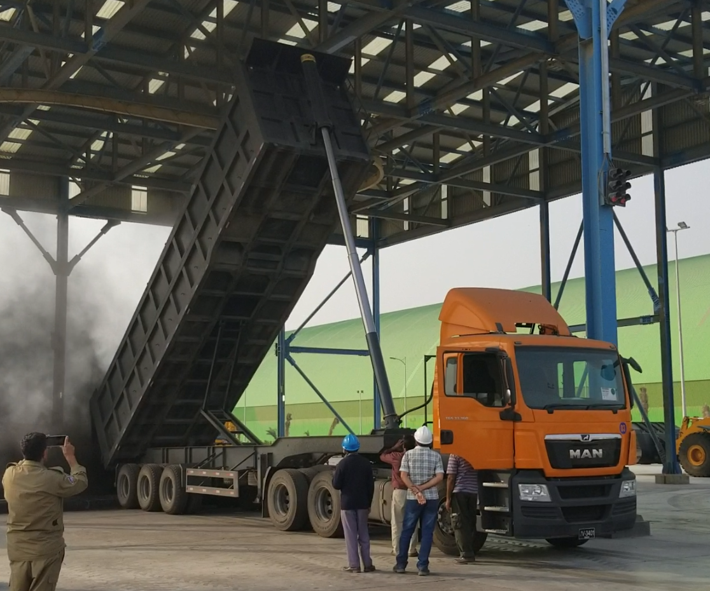
Semi-Trailer Industry – Classification and Dimensions
Specialized transport like Tippers for Coal movement require wider base for stability against rollovers.
Globally tipper trailer width is 3000 mm
Pakistan tipper trailer width is 2550 mm
With Thar Coal movement having taken off, we request that tipper trailers be allowed with 3000 mm OAW as “Articulated Wide Bed” Category GVx5/6w under S.R.O. 308(I)/2018 “Dimensional Rules of Goods Transport Vehicles”

Slide 15
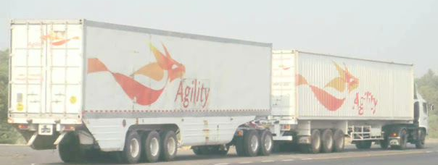
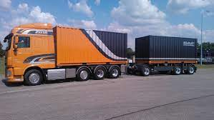
Semi-Trailer Industry – Classification and Dimensions
b. Road Trains and draw bar trailers are not included in the “Dimensional Rules of Goods Transport Vehicles.”
Solution: A study to be conducted with stakeholder input to assess under what conditions road trains and draw bar trailers and can be operated especially with regional connectivity agreements.
Road Train made by AUTOCOM in 2008

Slide 16
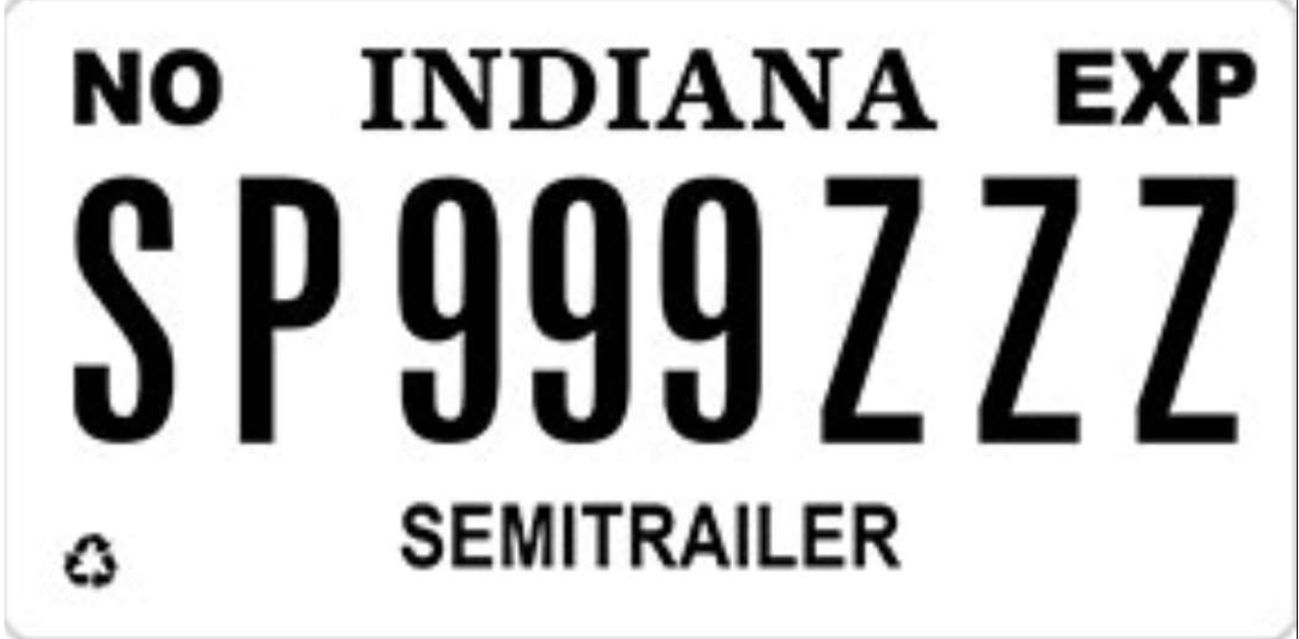
Trucking - Sector Recommendations
Semi-Trailers should be registered as a vehicle (as is common practice in other countries) to allow for traceability, liability, generating greater revenue for the GoP and the provincial governments.
A federal Ministry of Transport should be established integrating all supply chain functions including Air, Sea, Road Transportation, Ports and Shipping.
Overloading to be rapidly phased out even if it requires subsidizing/incentivizing commodity producers (cement, steel, fertilizer and coal transport by road)
A comprehensive Trucking Policy should be implemented
Manpower to be trained to manage specialized tasks for transit trade
Federal financial sector authorities and banks to collectively develop and implement low-cost financing schemes e.g., truck owners can exchange their old vehicle for a down payment or reduced costs for the import of a new or semi-new (less than 5 years old) vehicle to replace scrapped vehicles
Notes:
Let us not forget that exports are highly dependent on trucking sector. If we cannot get the shipment on the vessel, we cannot generate the B
Produce a comprehensive goods vehicle scrapping program that will:
Allow zero duty and tax certificates for new replacement vehicles
Free road tax and licensing for replacement imports for 3 years
Transferable/ tradable certificates for scrapped vehicles

Slide 17

Thank You

